Slide 1
The Development of Self-Government in the Thirteen American Colonies

Slide 2
An Abuse of Power
At the beginning of the 13th Century, King John ruled over England.
As England’s monarch, or king, King John used unfair practices to control the people such as:
Unfair taxes
Rules that limited individual rights
Dictatorial style leadership

Slide 3
Establishing the Foundation for Self-Government
King John’s actions angered the people of England, especially the English nobles.
Using their political and economic power, the nobles forced King John to sign a charter protecting the fundamental rights of the people.
Signed on June 15, 1215 this charter became known as the Magna Carta, or the “Great Charter”.

Slide 4
The Magna Carta
The charter limited the king’s power and protected specific individual rights of the people. Rights like:
Due process of law
Property protection
Proper taxation
Although many of the rights protected under the Magna Carta only served a small portion of the population—the wealthy nobles—it served as a foundation for future protection of rights for all people.

Slide 5
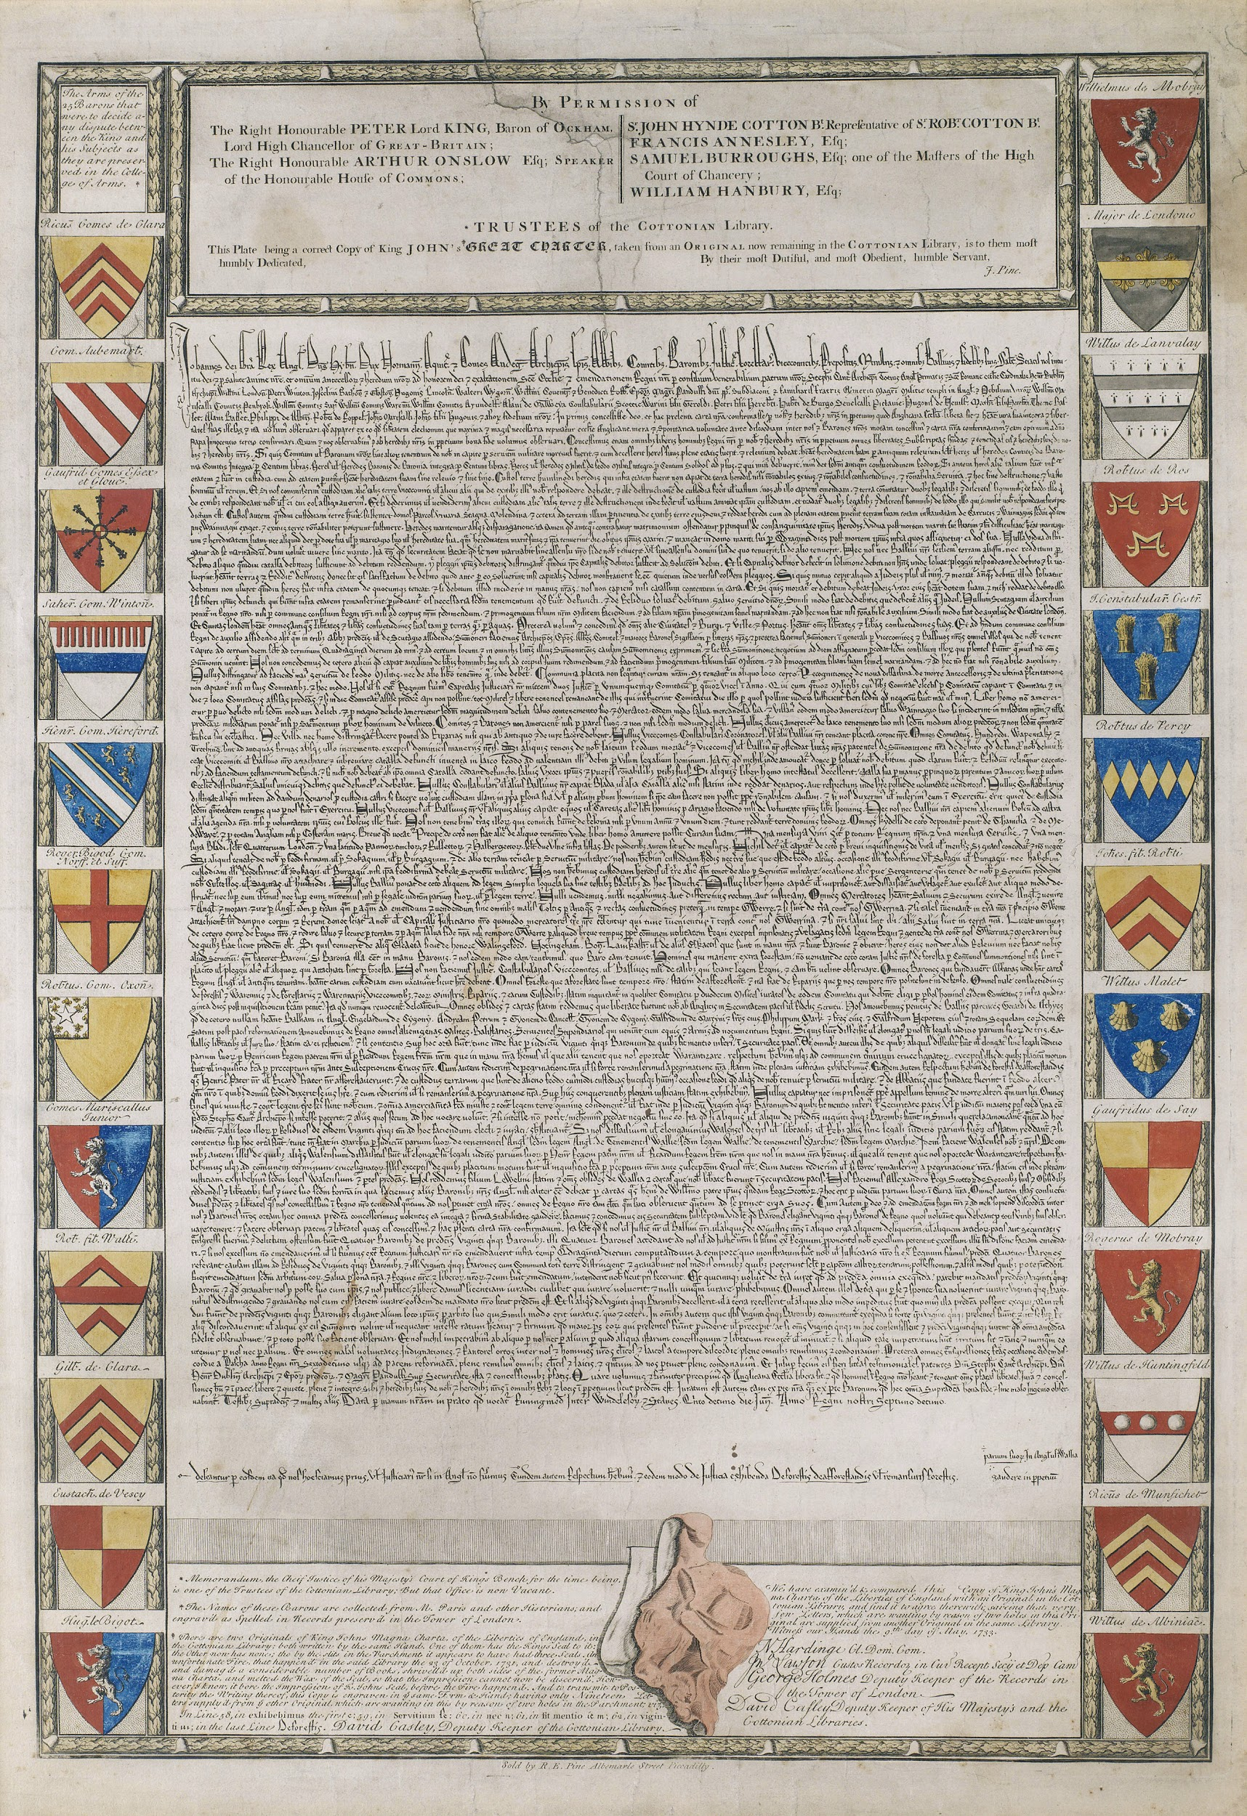

Slide 6
The Importance of the Magna Carta
First written Western document acknowledging the protection of individual rights.
English tradition and structures served as an example for future English and colonial documents.

Slide 7
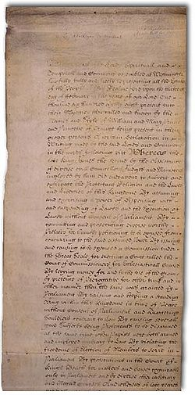
English Bill of Rights
In 1689, England’s Parliament furthered the protection of individual rights by forcing the King of England to sign into effect the English Bill of Rights.
The English Bill of Rights served as an example for colonial bills of rights, as well as the first ten amendments of the U.S. Constitution, which became known as the Bill of Rights.

Slide 8
American Colonial Rights
The English men and women who traveled to the New World considered themselves to be English citizens.
As citizens of England, they expected to maintain their English rights while in the American colonies.
To ensure they maintained their rights, especially in vastly isolated communities, they established colonial governments that would support self-government and the protection of individual rights.
Protestantism called for independent churches which used self-government. This was a contrast to what citizens of England were used to under Catholicism which relies on a centralized hierarchy.
Three of these colonial governments were:
Virginia House of Burgesses
Mayflower Compact
Fundamental Orders of Connecticut

Slide 9
Virginia House of Burgesses
Established in 1619, the Virginia House of Burgesses served as the first colonial assembly in the Thirteen Colonies.
A colonial assembly consisted of persons elected as representatives to government. The colonial assembly met to determine laws and governmental polices for the people of their colony.
The Virginia House of Burgesses was the first representative government in the colonies.

Slide 10
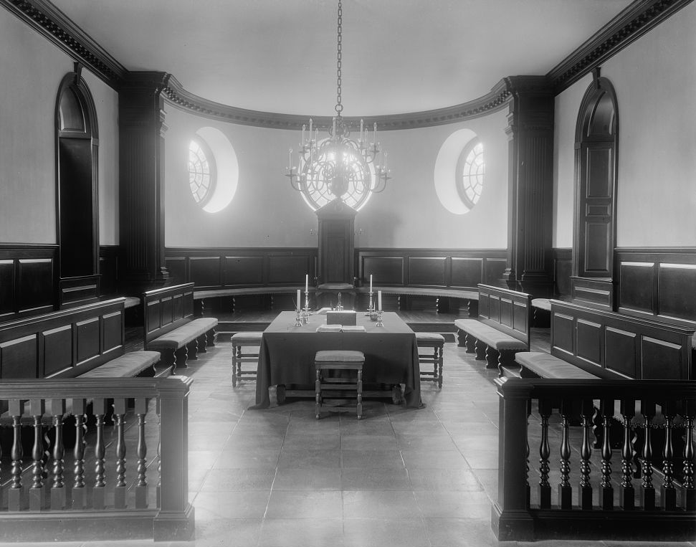

Slide 11
Mayflower Compact
In 1620, the Pilgrims and Puritans traveling to Virginia on the Mayflower encountered a storm in the Atlantic and their boat moved almost 1,000 miles off course.
Outside the jurisdiction of Virginia Law, the male members of the Mayflower drew up a compact that guaranteed a democratic system of government and the protection of individual rights.
This compact became known as the Mayflower Compact.
The Mayflower

Slide 12
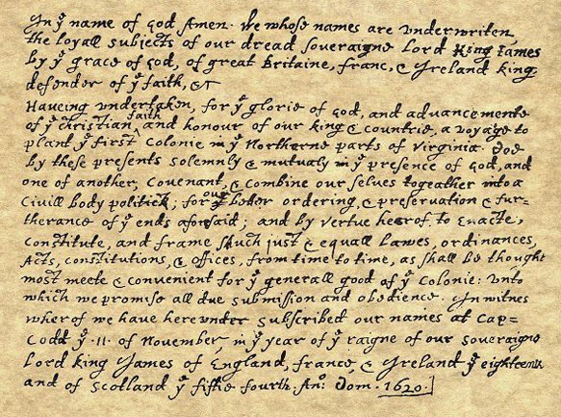

Slide 13
Fundamental Orders of Connecticut
The Fundamental Orders of Connecticut served as the first written colonial constitution.
Adopted in 1639, the Connecticut’s constitution protected the individual rights of the Connecticut colonists.
The constitution also established a religious tolerant government and helped to serve as an example for future colonial constitutions.

Slide 14
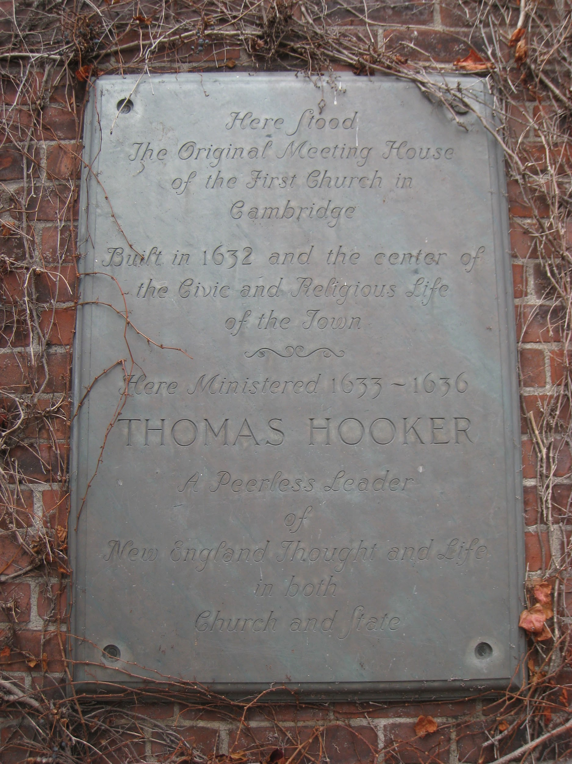

Slide 15
The Results of Colonial Self-Government
Colonists believed their rights as British citizens were secured by both the British and colonial governments.
The long distance from a centralized government and existence under salutary neglect caused the colonists to become self-governing and politically self-sufficient.
It would not be until the British government threatened the status of American colonists’ self-government that the colonists decided to rebel.

