Slide 1
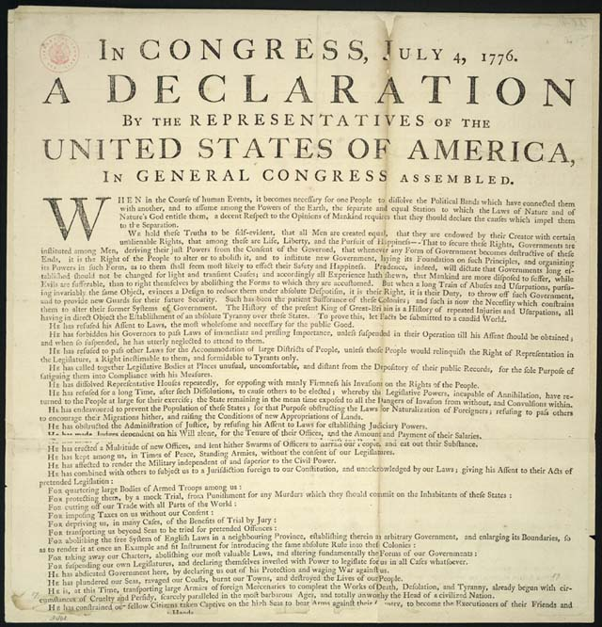
Declaration of Independence

Slide 2
The Declaration of Independence
WHO? | THOMAS JEFFERSON AND OTHER AMERICAN PATRIOTS
WHAT? | A LETTER TO KING GEORGE OF ENGLAND
WHEN? | JULY 4TH, 1776
WHERE? | INDEPENDENCE HALL PHILADELPHIA, PA
WHY? | WRITTEN TO OFFICIALLY BREAK TIES WITH ENGLAND

Slide 3
Parts of the Declaration of Independence
PREAMBLE: Sets goals of the Declaration of Independence
GRIEVANCES: List of complaints against King George
CONCLUSION & SIGNATURES
NATURAL RIGHTS: Life, Liberty and the Pursuit of Happiness

Slide 4
The Declaration of Independence is one of the
most important documents in the history of the United States.

Slide 5
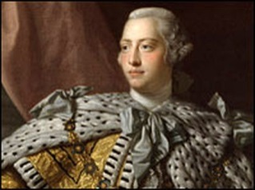
The Declaration of Independence told King George that the colonists did not want to be part of England
any more.

Slide 6
This document represented the official first step toward
the separation of the 13 colonies from the control
of Great Britain.

Slide 7
It also stated that the colonists
had the right to 3 things…
1. Life
2. Liberty (freedom)
3. Pursuit of
Happiness

Slide 8
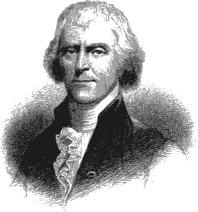
The document was
written by
Thomas Jefferson,
in seventeen days,
during the
Second
Continental
Congress.

Slide 9
Congress voted to approve the Declaration
of Independence on July 4, 1776.

Slide 10
This is why we celebrate July 4th
as America’s Independence Day!

Slide 11
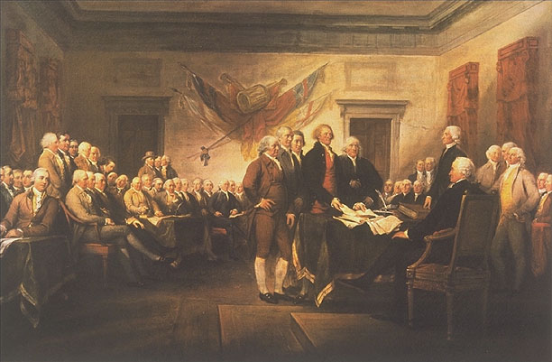
After the Declaration
of Independence was
signed....

Slide 12
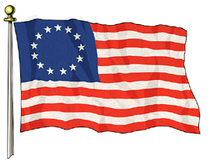
A new nation
was BORN.....
The United
States of
America!

Slide 13
The End

