Slide 1
Causes of the Revolution
Summary

Slide 2

The French and Indian War
Explanation
Britain needed money to finance war with France.
Reaction/ Result
Britain imposed taxes on the colonists to pay for the war.

Slide 3

Proclamation of 1763
Explanation
Britain wanted to avoid conflict with Native Americans, so Colonists were forbidden to cross Appalachian Mountains.
British Army stationed in the colonies
Reaction/ Result
Colonists were angered because of British presence and being told what to do

Slide 4

Sugar Act
Explanation
Tax on sugar and molasses
Reaction/ Result
Did not affect many, but the idea of taxes a growing issue

Slide 5
Stamp Act
Explanation
Tax on legal documents, newspapers, wills, and basically every piece of paper used
Reaction/ Result
Stamp Act Congress formed to organize boycott
Eventually repealed

Slide 6

Writs of Assistance
Explanation
Customs officers could search ships at will
Reaction/ Result
Few colonists affected, but merchants felt this was an invasion of privacy

Slide 7
Townshend Acts
Explanation
Tax on various household items such as paper, glass, lead, silk, and tea
Reaction/ Result
Colonists boycott through the non-importation agreement
Eventually repealed

Slide 8
Quartering Act
Explanation
Colonists had to provide food, housing, blankets, candles, etc. for the British soldiers
Reaction/ Result
This was hated, but little could be done

Slide 9
Intolerable Acts
Explanation
Colonists could not hold town meetings
Port of Boston closed
Customs officials tried in Britain
Reaction/ Result
First Continental Congress meets
Individual colonies began to unify

Slide 10

“No taxation without representation!”
Explanation
Colonists had no representatives to speak for them in Parliament
Reaction/ Result
Colonists resented not having a say in their own affairs
Became a rallying cry

Slide 11
Other Acts and Events

Slide 12
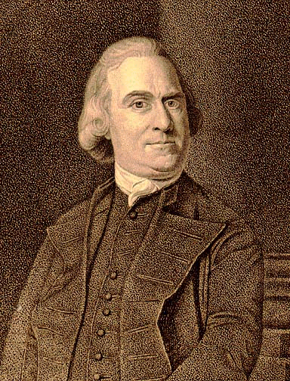
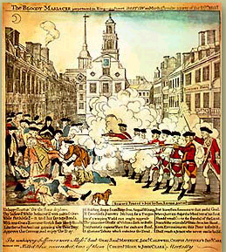
The Boston Massacre
Explanation
A rioting mob confronted British soldiers at the Boston Customs House
Tensions rose and shots were fired into the crowd, killing five colonists
Reaction/ Result
Sam Adams used the opportunity to whip up anti-British feeling by calling the event a “massacre”
Two soldiers were found guilty of manslaughter, six were found not guilty

Slide 13
Tea Act
Explanation
Tea merchants in the colonies were cut out of the tea trade because the British East India Company lowered their tea prices.
The company monopolized, or controlled, tea sales in the colonies.
British East India Company
Reaction/ Result
Boston Tea Party

Slide 14
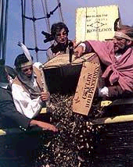
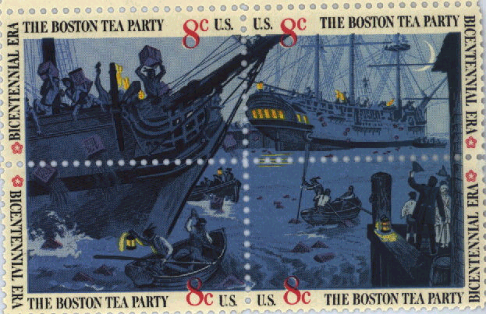
Boston Tea Party
Explanation
On December 16, 1773, the Sons of Liberty dumped 90,000 pounds of tea into Boston Harbor.
Reaction/ Result
Intolerable Acts

Slide 15
Chronology of Events
French and Indian War- 1754-1763
Proclamation of 1763- 1763
Sugar Act- 1764
Stamp Act- 1765
Writs of Assistance- 1767

Slide 16
Chronology of Events
Townshend Acts- 1767
Quartering Act- 1765
Boston Massacre- 1770
Tea Act/ Boston Tea Party- 1773
Intolerable Acts- 1774

